Slide 1
Prospect Creator +
Online Data Management Platform for marketers, listowners & publishers

Slide 2
Why online?
Access to system from any number of sites in any geography
Fully hosted solution delivers competitive cost of ownership
Simple web user interface means minimal training needed

Slide 3
How does it work
Users run counts and create and manage campaign segments or data orders for marketing campaigns
Quickly and easily segment a data-set to create targeted audiences for single or multi-channel campaigns
Analyse segments using advanced cross tabulation reports
Instantly download data for campaigns
Create detailed data cards at the click of a button.

Slide 4
Customised to your exact requirements
Configured specifically to work with your data whether it's B2B or B2C, whatever attributes you have
Modular functionality to suit the exact needs of your business and its clients
Fully branded to your corporate look and feel

Slide 5
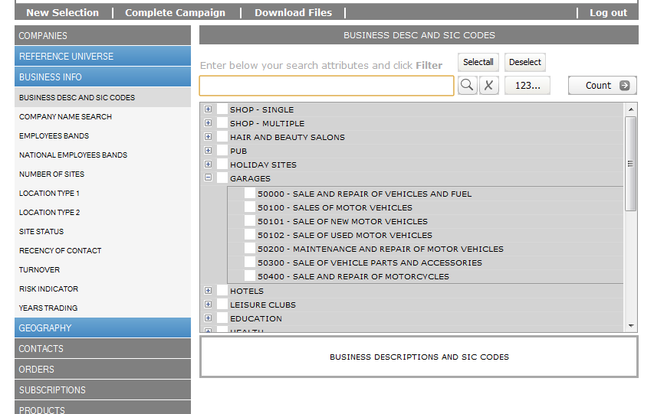
Limitless Numbers of Attributes

Slide 6
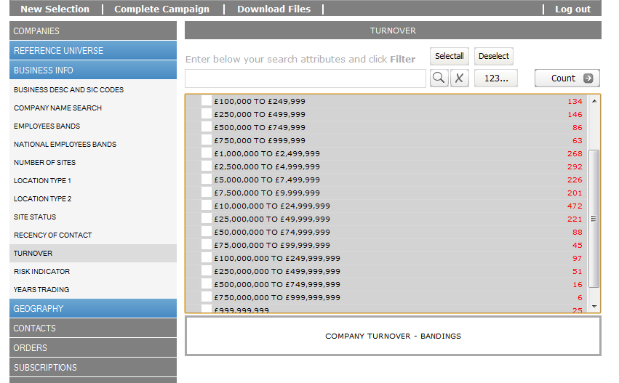
Intermediate Counts

Slide 7
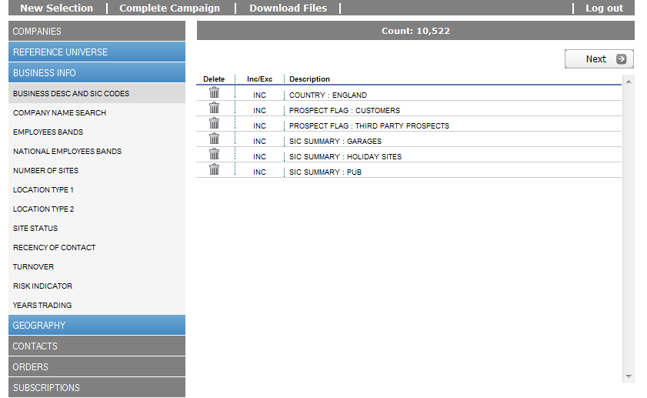
Fast Counts in seconds

Slide 8
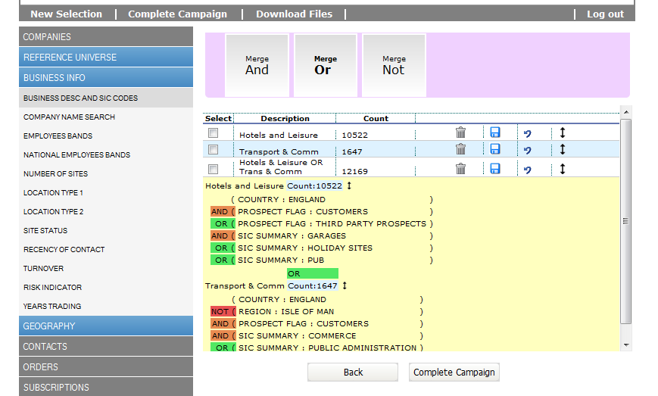
AND, OR, NOT logic
Create multi cell campaigns with boolean logic

Slide 9
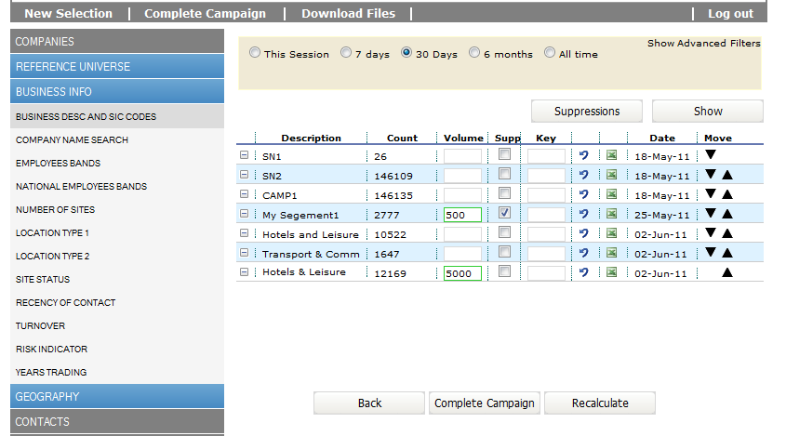
Multi segment campaigns
Build a campaign from multiple de-duplicated segments

Slide 10
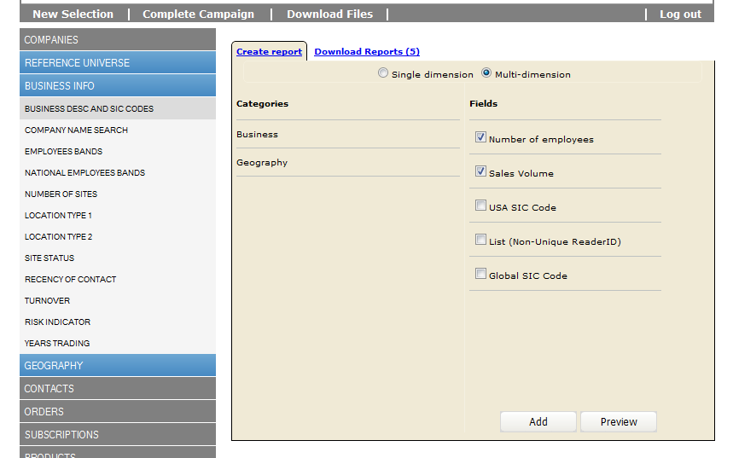
Create breakdown reports

Slide 11
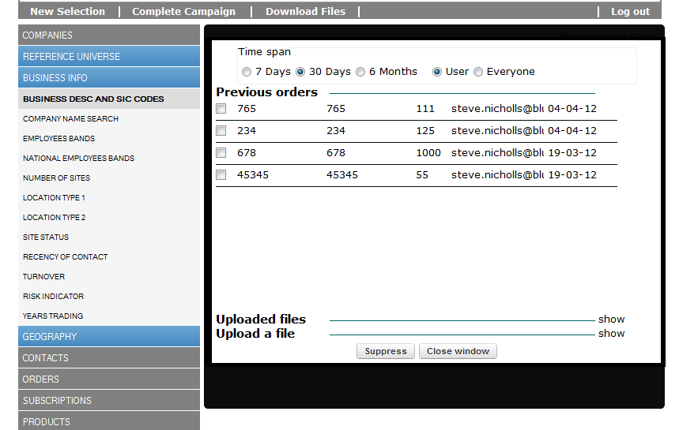
Suppress Previous Orders

Slide 12
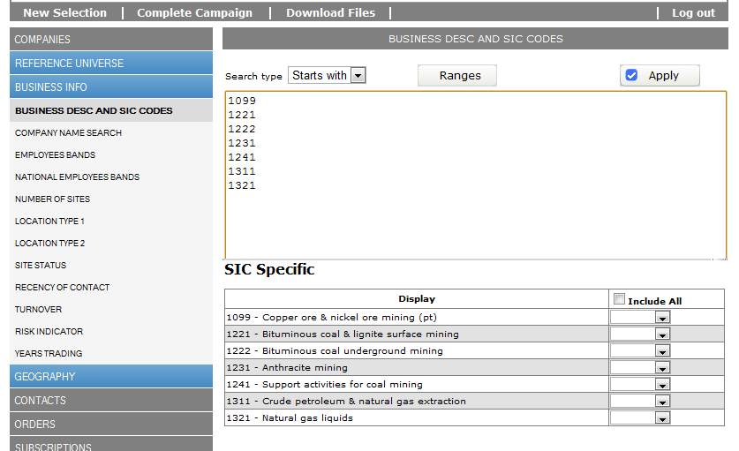
Paste and Search

Slide 13
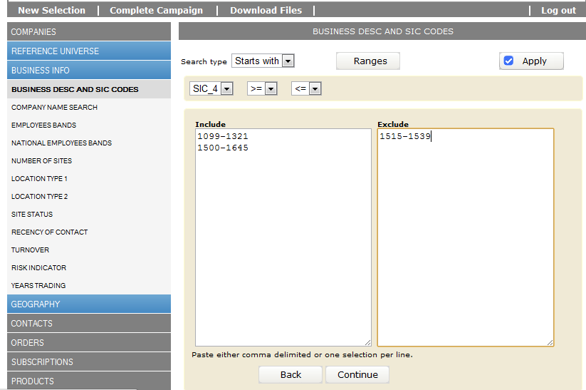
Range Search

Slide 14
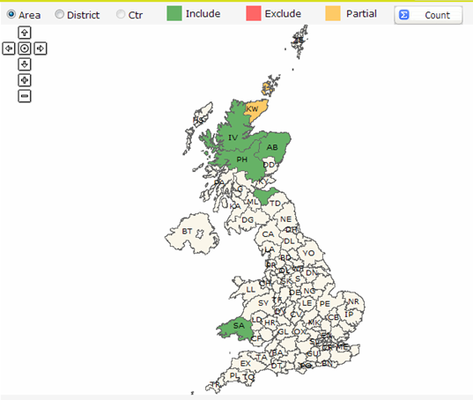
Clickable Postal Map for any country

Slide 15
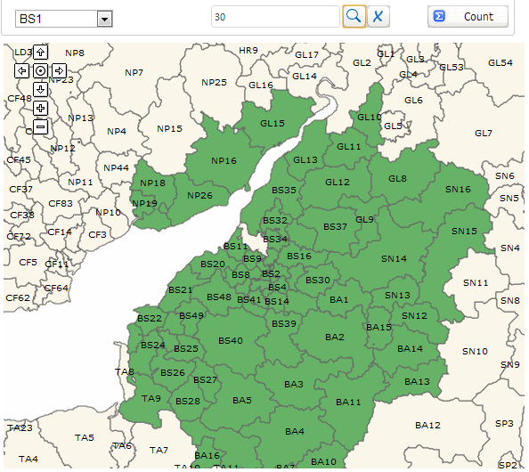
Drive-time or distance search for any country

Slide 16
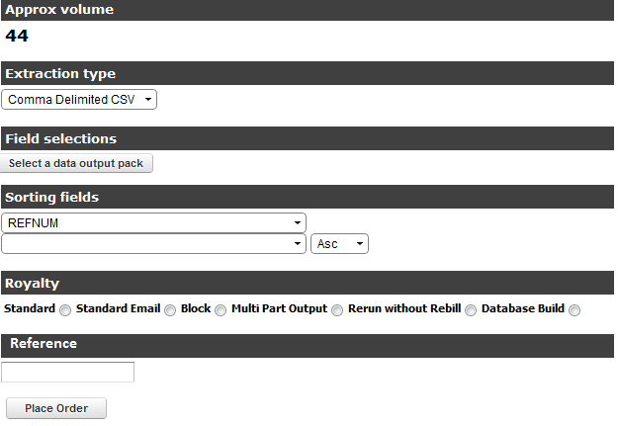
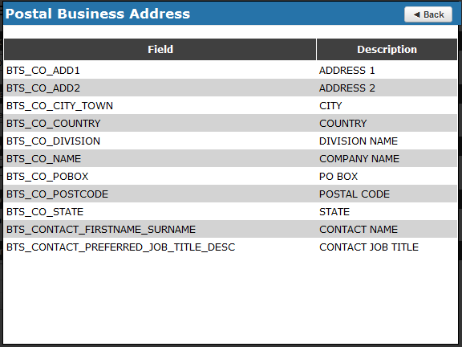
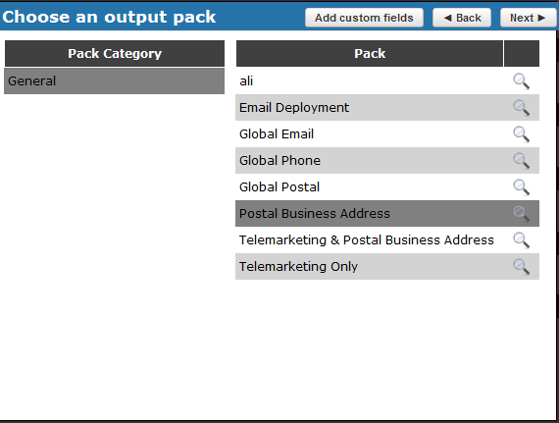
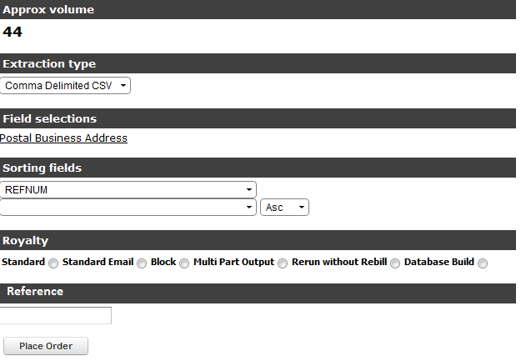
Multiple output layouts

Slide 17
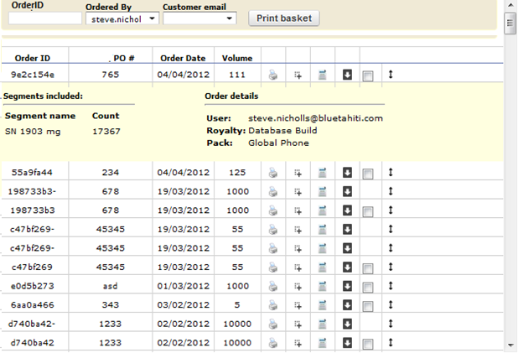
Download Order to desktop

Slide 18
Benefits
Build more targeted campaigns faster
Campaign planners no longer reliant on IT department
Competitive cost of ownership
Millions of prospects at your fingertips
Fast counts on multi-million rows
Full support for AND/OR/NOT logic
Multi-cell campaigns
Prior order suppression

Slide 19
Benefits
Data downloaded directly to desktop
Order history maintained for full prior order suppression capability
Configurable output layouts
Fully hosted – zero IT resources
Minimal training needed
Incremental daily/weekly updates of any attribute e.g. opt-outs

